Slide 1
LEADERSHIP CAMP 2021
Reflecting. Planning. Activating
Tatyana Arendarenko
First City IT-Lyceum

Slide 2
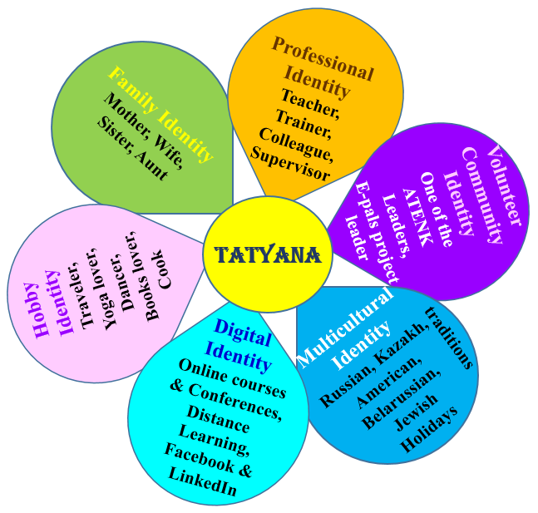
LEADERSHIP CAMP 2021
Integrating Critical Thinking Skills into the
Exploration of Culture in an EFL Setting
The Identity Wheel
Our values reflect what is important to us in life.

Slide 3
LEADERSHIP CAMP 2021
Moving through cultures
Home;
Your school;
Your classroom;
Supermarket;
Your friend’s house;
Clubs/ Discos/Cafes;
Mosque/ Church;
………

Slide 4
LEADERSHIP CAMP 2021
What are core elements (Practices, Products, Perspectives) that makes ATENK a culture?
What do you need to know/ do to belong in ATENK?
Is ATENK open to everyone?
What aspects of yourself belong ‘comfortably’ in ATENK?
What do you have to change about yourself when you are in ATENK?

Slide 5
LEADERSHIP CAMP 2021
Culture
Products
Practices
Perspectives
make
do
John H. Bodley
think

Slide 6
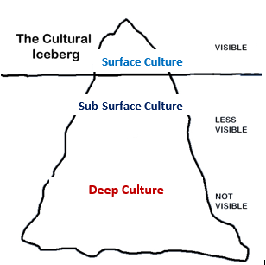
What are core elements (PPPP)that makes
ATENK a culture?
Edward T. Hall’s iceberg analogy of culture (1976)
LEADERSHIP CAMP 2021

Slide 7
LEADERSHIP CAMP 2021
What are ATENK’s elements that make us a culture?
ATENK Conferences
ATENK Tournament
English song Contest
Best Teacher Award
ATENK Leadership Camp
Products

Slide 8
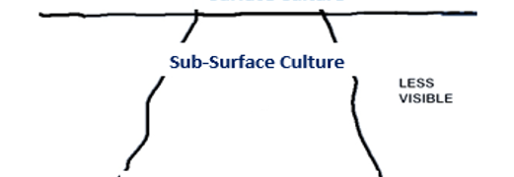
LEADERSHIP CAMP 2021
experience sharing
recognition
collaboration
promotion
providing opportunities
cascading
knowledge
training
Practices
attitudes
communication

Slide 9
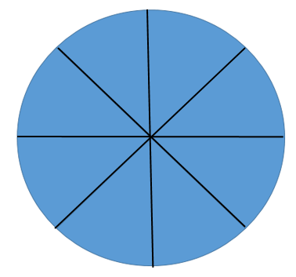
LEADERSHIP CAMP 2021
Leadership Pizza
Passion & Purpose
Integrity
Self-awareness
Vision & Inspire
Self-efficiency
Empathy
a reflection and
self-assessment tool
Prioritization
Value &
Acknowledge People

Slide 10
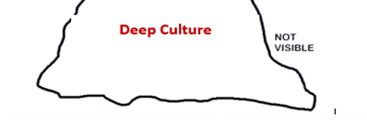
LEADERSHIP CAMP 2021
Perspectives

Slide 11
LEADERSHIP CAMP 2021
What do we believe? · How does my personal vision fit within the larger context of my family, my community, my job? · How do I create a shared belief that my vision will help the organization succeed within the larger community and also help the community succeed? · What do we believe we stand for as a regional organization? How should we behave to accomplish what we stand for (guiding principles/values)? Do my values align with the organizational values? · How do I reconcile differences between my values and those of my organization? How will these differences impact my ability to develop toward my vision and goals?

Slide 12
LEADERSHIP CAMP 2021
HOW TO DESIGN YOUR LEADERSHIP DEVELOPMENT PLAN:
1. Assess Where You Are Professionally
2. Set an Attainable Goal
4. Interact with Your Network, ATENK
3. Engage in Leadership Training
5. Hone Your Soft Skills

Slide 13
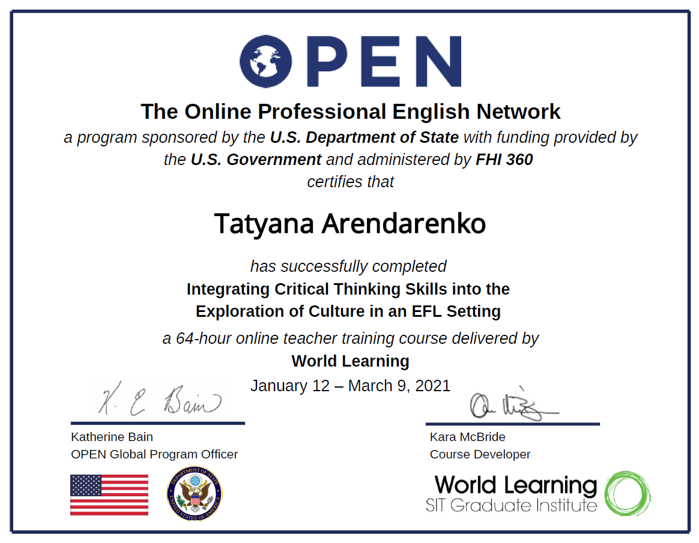
LEADERSHIP CAMP 2021

