Slide 1
Leading teacher development

Slide 2
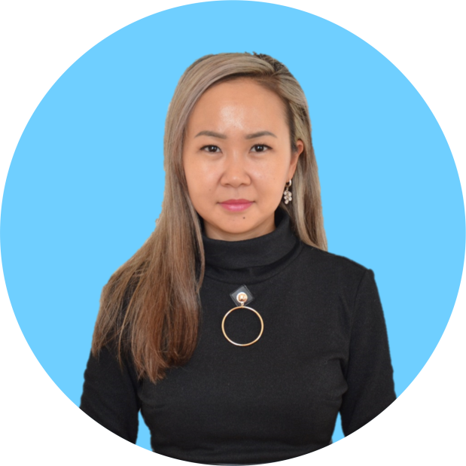
Zhainagul Ibrayeva
- English teacher at Quantum STEM school in Nur-Sultan
- Master of Pedagogical Sciences
Trainer of the updated English curriculum
CLIL Trainer
International certificates:
TKT
CELTA
Train the Trainer (TTT)
- Owner of a language school
‘Unicorn Language School’ in Nur-Sultan
- MA in TESL instructor in Kazakhstan
(faculty member of Webster University, St. Louis, Missouri, USA)
zhainagul.ibraeva@quantum.edu.kz
WA 87054433785

Slide 3
Leading Teacher Development
Continuous Professional Development and how to maintain it
Notes:
30 seconds

Slide 4
Leading Teacher Development
Activity 1: 10-minute activity.
Work in pairs. Think about all of your development as a teacher, from pre-service (at university) to the present day. Identify and tell your partner about at least three useful ideas you have come across during that time which have really improved your teaching.
For each idea, explain:
What it involves
Where you came across the idea
How it has had an impact on your teaching.
[feedback]

Slide 5
Leading Teacher Development
What is Continuous Professional Development (CPD)?
In order to understand the concept of Continuous Professional Development (CPD), it is first worth looking at the differences between Teacher Training and Teacher Development.

Slide 6
What is Teacher Training?
Equips an individual to carry out the job of teaching.
A course of training in skills of teaching (e.g. skills and techniques to teach grammar, lexis, pronunciation, reading etc.) plus skills of classroom management.
Comes from "outside" – from a course and from a trainer or group of trainers.

Slide 7
What is Teacher Development?
"Teacher development is the process of becoming the best teacher one is able to be, a process that can be started but never finished" (Underhill, A. IATEFL Issues, June/July 1999, 149: 17).
One way of looking at this kind of development is to question what experience means. Does "10 years" experience mean the same year experienced 10 times or has the individual with that experience moved forward, experimented and developed as a teacher during that period?

Slide 8
Leading Teacher Development
Activity 2: 10 to15-minute activity.
Work in the same pairs as in activity 1. Think about the useful ideas you identified in activity 1. Discuss with your partner:
How many came about as a result of teacher training and how many came about as a result of teacher development?
Which ideas have changed your practice most?
What are your general reflections after discussing (a) and (b)? [feedback]

Slide 9
If Teacher Development comes from within the individual practitioner how does this differ from the notion of CPD?

Slide 10
Cont’d
Commitment of the organization where the individual is employed.
CPD implies both the commitment of the individual and the commitment of the institution.
Teacher Development can be regarded as more or less a voluntary activity but CPD is much more a requirement for all employees of a given organization, the aim of which is to benefit not only the individual but also the organization and, ultimately, the profession as a whole.
In order to implement CPD the individual teacher makes a commitment to develop and move in some way and that commitment is endorsed and actively supported by the organization.

Slide 11
Leading Teacher Development
Activity 3: 20-minute activity.
Work in groups of four. One person should be the reporter, noting the conclusions of the group for later reporting.
Discuss:
How important is CPD to (i) the teacher (ii) the organisation?
What kinds of activities are valid development activities which an organisation (eg a school) might support?
What proportion of a teacher’s time during the year should be devoted to CPD activities?
How can an organisation support each individual teacher’s CPD? [feedback]

Slide 12
What kinds of activities are valid development activities which an organisation (eg a school) might support?
attending external events such as workshops, seminars or conferences,
following a specialized training course
getting a higher qualification
becoming a member of a Special Interest Group (for example, the IATEFL Pronunciation SIG)
leading in-house and external workshops and seminar
writing teaching materials
publishing articles
becoming more informed about current literature on language teaching and linguistics
observing other teachers and being observed oneself.
Continue the list

