Slide 1
ATENK CONFERENCE 2021 „Teaching EFL in the new normal: challenges and opportunities of creating a successful learning environment “
Alexandra Ilina
Teacher of English, School #8
Petropavlovsk

Slide 2
The OPEN (Online Professional English Network) Program Global Online Courses (former American English E-Teacher Program) sponsored by the U.S. Department of State with funding provided by the U.S. Government and administered by FHI 360.
OPEN Program Global Online Courses:
Introduce and explore current methodological concepts and issues in the English as a Foreign Language field
Provide an innovative distance-learning experience that uses the latest technology
Connect participants with U.S. English language teaching experts and creates a professional network of international colleagues
The info is taken and screened from: https://www.openenglishprograms.org/

Slide 3
What does the OPEN offer?
English for Science, Technology, and Mathematics (STEM)
Assessment of English Language Learners
TESOL Methodology
Teaching English to Young Learners
English for Media Literacy for Educators
Professional Development for Teacher Trainers
The picture is taken from: https://www.teachingenglish.org.uk/

Slide 4
Professional Development for Teacher Trainers This course is delivered by Arizona State University
The main outcome of the course is to have participants apply teacher training tools and strategies for impactful training in their local contexts.
The picture is taken from: https://www.aid-turk.org/training-unit/
The picture is taken from: https://americanenglish.state.gov/

Slide 5
Section: “EFL teacher development” topic: “Four-step approach to teacher training”
Alexandra Ilina
Teacher of English, School #8
Petropavlovsk

Slide 6
Four steps to conduct a teacher training
1 Classroom teacher vs Teacher Training
2 Setting up topics and objectives
3 Ways to engage teacher
4 Final training plan
Teacher training

Slide 7
Brainstorm – Teacher Training/Workshop in 5 Words
When you think of workshop, what five words come to mind? What are the first five words you can think of?
Instructions: Write the five words in a post on the discussion forum. Remember that this is a discussion, so there are no "right" or "wrong" answers. You're just sharing your own ideas.
EXAMPLE:
Teacher Training/Workshop in 5 Words: constant, enriching, reflective, maintaining, collaborating

Slide 8
Graphic organizer – Comparing Classroom Teaching and Teacher Training

Slide 9
Start filling your toolbox
JIGSAW READING
WORD BANK
GRAPHIC ORGANIZERS
LESSON PLAN MIX-UP
JIGSAW VOCABULARY, ETC.

Slide 10
What are some possible professional development topics?
Think about your teaching context. Think about the students in your classes, the other teachers in your school, and your school. What areas of your teaching practice would you like to develop? What kinds of professional development topics do you think other teachers in your school could use? Which topics would help you in the classroom?
Instructions: Make a list of THREE/FIVE possible topics of professional development. Later on, you can use this list to choose a topic to design your teacher training workshop.

Slide 11
Choose Training Topic and Set Goal(s)
1. Choose one of the training topics that you listed.
2. Think about what you would like to achieve in training on this topic. What do you want your participants to be able to do by the end of your training?
Retrieved from: https://www.freepik.com/free-vector/smart-goals-setting-diagram-template_1430853.htm#position=1

Slide 12
Look at the Graphic organizer and choose 3 engagement tips that you would like to try out in your teacher training/workshop. Choose tips that you think would be successful in your teaching context. Think about why you want to try them.

Slide 15
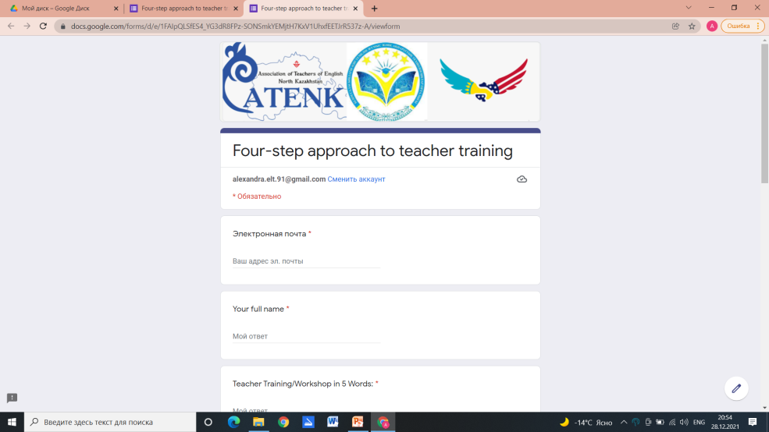
Reflection link: https://docs.google.com/forms/d/e/1FAIpQLSfES4_YG3dR8FPz-SONSmkYEMjtH7KxV1UhxfEETJrR537z-A/viewform
Materials: https://drive.google.com/drive/folders/1DqOsyrRx-IYirYb2gNWPE1nRNU42mk_w

Slide 16
ATENK CONFERENCE 2021 „Teaching EFL in the new normal: challenges and opportunities of creating a successful learning environment “
Alexandra Ilina
Teacher of English, School #8
Petropavlovsk

