Slide 2
English Language Fellow Program
The U.S. Department of State English Language Fellow Program sends experienced TESOL professionals from the United States on teaching assignments at universities and other academic institutions around the world. In Kazakhstan, the EL Fellow Program provides highly qualified teachers of English as a foreign language to Kazakhstan Universities.
English Language Fellows work closely with English language teachers, students, and education professionals to improve English language teaching capacity. Program participants serve as representatives and cultural ambassadors of the United States.
During the 2021-2022 academic year, two English Language Fellows are placed in Kazakhstan Educational Institutions: August Garnsey at Gumilyov Eurasian National University and Seth Sinclair at Almaty branch of the National Center of Professional Development Orleu.
You can find more information about this program here: https://elprograms.org/fellow/

Slide 3
English Language Specialist Program
Provides specialized training for In-Service Institutes, schools, universities and other academic institutions conducted by American academics, experts and teacher trainers in the fields of English as a Foreign Language, Methodology of English Language Teaching and Applied Linguistics on a short-term basis throughout the Central Asia region.
These American experts can facilitate workshops, seminars and conference keynotes on topics such as curriculum development, teacher training and education, textbook development, English for Specific Purposes, program evaluation, and many other topics.
This year, due to COVID 19, we work with the Virtual English Language Specialists, who can meet with audiences online providing workshops and trainings.
More information on this program can be found here: https://elprograms.org/specialist/

Slide 4
English Access Microscholarship Program
Provides a foundation of English language skills, leadership training, and knowledge of U.S. culture to talented 13-20 year-old teenagers from economically disadvantaged sectors through after-school classes and intensive sessions for two years. Access programs are based throughout the Central Asia region. Currently all Access programs in Kazakhstan are in online mode.
https://exchanges.state.gov/non-us/program/english-access-microscholarship-program

Slide 5
Massive Open Online Courses (MOOC)
The Online Professional English Network (OPEN) Program has many Massive Open Online Courses (MOOCs) for English language teachers, students, and other professionals. These free MOOCs are hosted on the Canvas Network platform and have included titles such as these (enrollment is open):
English for Media Literacy
English for Journalism
English for Business and Entrepreneurship
English for Media Literacy for Educators (EML-E)
Assessment of English Language Learners
Establishing Academic Writing Centers at International Higher Education Institutions
Using Educational Technology in the English Language Classroom
Participants who complete these MOOCs with a 70% passing rate or higher are eligible to receive a digital badge and e-certificate from the U.S. Department of State.
Check out all of our currently open courses and register here:
https://www.openenglishprograms.org/MOOC

Slide 6
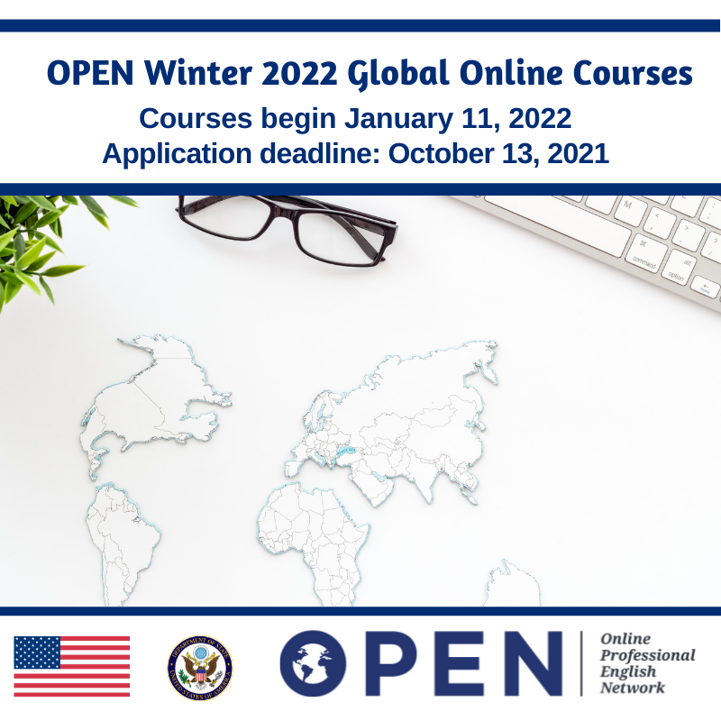
OPEN Global Online Courses for English Teachers
The OPEN (Online Professional English Network) Program offers English teaching professionals in Central Asia the opportunity to take innovative, online university-level classes and online professional development programming for teachers through FHI360. https://www.openenglishprograms.org/GOC_Information
Program length: 8 weeks
Courses Offered:
Content-Based Instruction
English as a Medium of Instruction (EMI)
Integrating Critical Thinking Skills in an EFL Setting
Professional Development for Teacher Trainers
Teaching English to Young Learners
Teaching Grammar Communicatively
TESOL Methodology
Using Educational Technology
How do I apply? Check our SM and website for the announcement
and email at RELO-Nur-Sultan@state.gov for the application form.

Slide 7
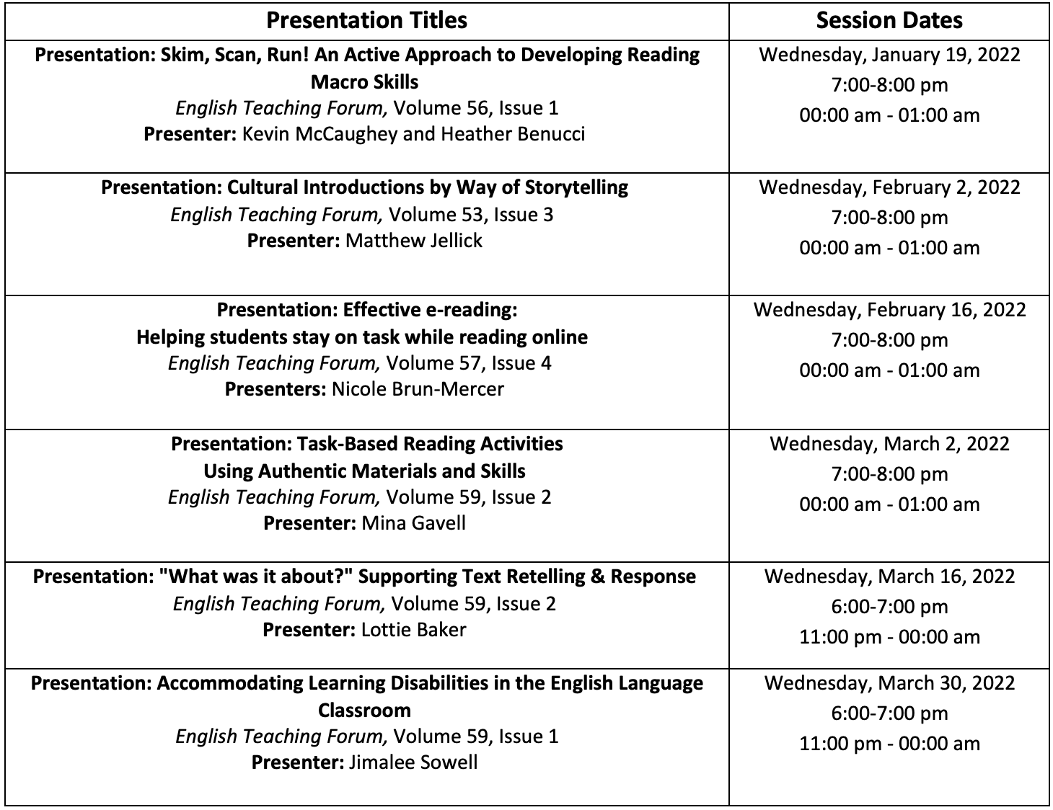
American English Live: Webinars for English Teachers

Slide 8
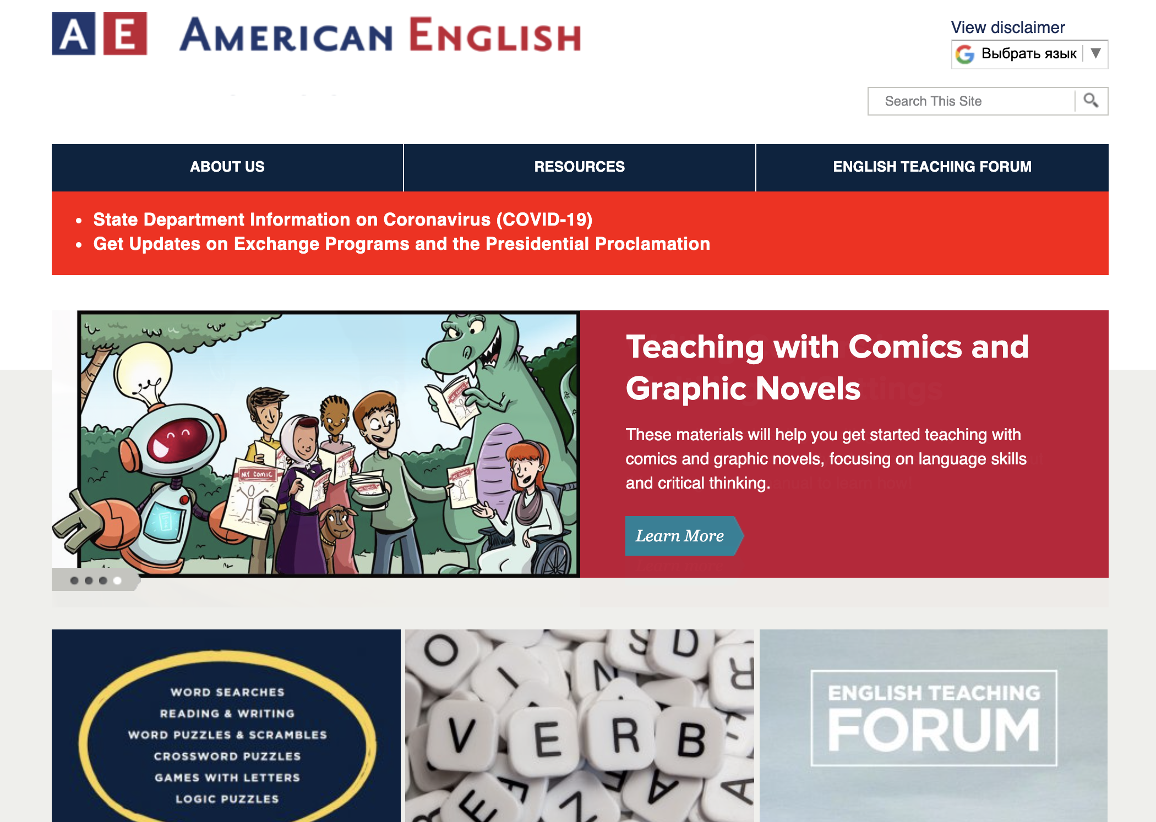
American English Online
American English Online is a website that provides resources for teaching and learning English and American culture. The website is updated bi-monthly and provides cutting edge resources teachers can easily adapt in their own classrooms or learners can use for self-study.
americanenglish.state.gov
Caption

Slide 9
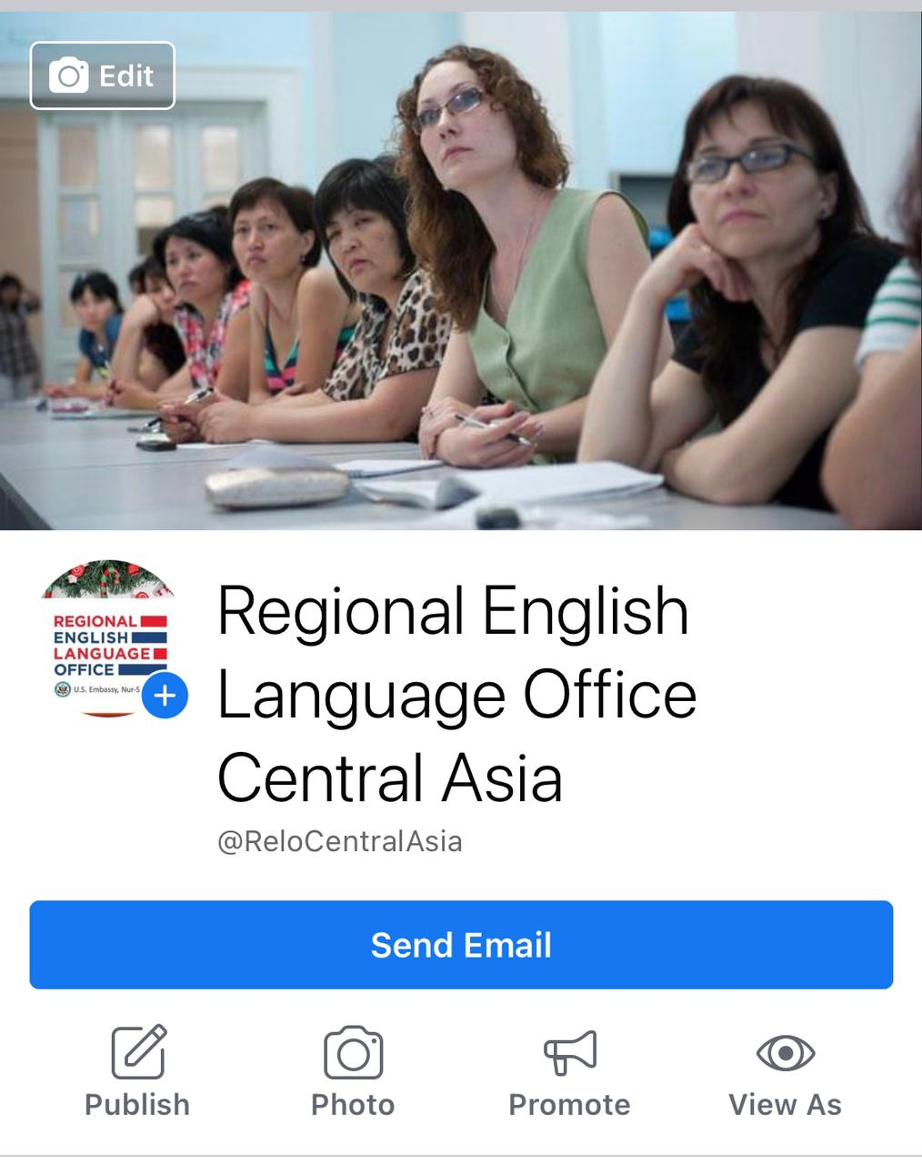
RELO Facebook page
https://www.facebook.com/ReloCentralAsia/
Follow us on the Facebook to:
Learn about the most recent updates on the RELO programs;
Get connected with English language teachers from the Central Asia countries;
Stay tuned for announcements

Slide 10
U.S. Embassy website, RELO webpage:
https://kz.usembassy.gov/education-culture/regional-english-language-office/
RELO Central Asia Facebook Page:
https://www.facebook.com/ReloCentralAsia/
American English at State Facebook Page:
https://www.facebook.com/AmericanEnglishatState/
American English for Educators Facebook Page:
https://www.facebook.com/AmericanEnglishforEducators/
AE Teacher's Corner Facebook Group:
https://www.facebook.com/groups/AETeachersCorner/
American English YouTube Channel:
https://www.youtube.com/user/StateAmericanEnglish
Questions? Email us at
RELO-Nur-Sultan@state.gov

