Slide 1
Engaging Critical Thinking
Ibrayeva Zhadyra Zhanbolatkyzy

Slide 2
What is critical thinking ? Why is it important nowadays? What are some easy ways to make CT part of teaching and learning language?

Slide 3
Tell us what you think!
What does critical thinking mean to you?

Slide 4
Learner who thinks critically can…
1)organize thoughts;
2)ask relevant questions
3)give their ideas beyond the particular topic;
4)gather relevant information;
5) creatively sort through information
6)come to reliable questions
7) solve complicated problems

Slide 5
Why is Critical thinking important nowadays?

Slide 6
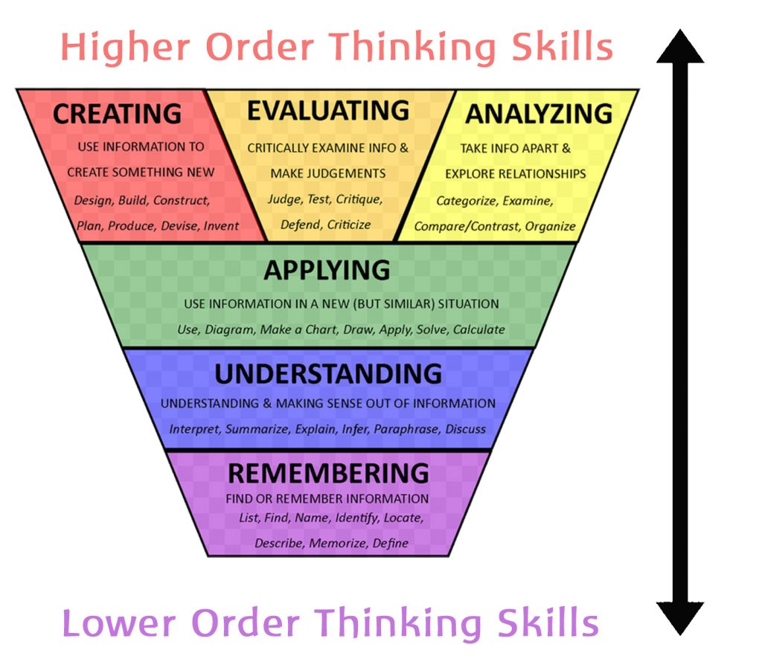
How can we help learners think critically?

Slide 7
What are some easy ways to make CT part of teaching and learning language?

Slide 8
Activity 1 Facts and opinion
My mom is the best mom on the Earth.
My dad is taller than your dad.
My telephone number is difficult to memorize.
The deepest part of the ocean is 35.813 feet deep.
Dogs make better pets than turtles.
Smoking is bad for your health.
85 percent of all cases of lung cancer in the U.S are caused by smoking.

Slide 9
Activity 2 Who is my hero?
-What is my definition of a “hero”?
-Who is a true hero to me?
- Why do I see this person as heroic?
-What do I learn from my “hero”?

Slide 10
Activity 3
Role plays and Verbal communication
Put the students in small groups or teams to maximize speaking time for all.
Vary the tasks to make it interesting
Give learners choices
Use active listening

Slide 11
Thinking about food
Card A: Plan a menu for a wedding dinner for 200 guests using only chicken, ice-cream, bananas and carrots.
Card C: It’s your job to make lunch for everyone at school today. You can cook your favorites. Prepare a shopping list.
Card B: You are famous in the world sports. You will swim in a 20 km race at Manhattan Island next month. You need to gain weight but stay strong. What 5 foods will you eat daily and why?
Card D: Your family is very sick. One person has a cold, one person has a broken hand, and one person has the hiccups. What will you feed them to help them feel better.
What card did you choose and what was your answer?

Slide 12
Activity 4 Problem solving
Give different problems to different learners
Allow for open ended solutions
Encourage respect for other point of view and ways of thinking
Let learners create puzzles and problems

Slide 13
Problem Solving activity Lost at sea Each group is in a life boat and lost at sea. Each group has a book of matches and things from the ship that sank
Group A
A large water boat
An axe
Mosquito repellent
Map and compass
Candy bars
Fishing role
Group B
A shovel
Freeze-dried food
Satellite radio
Shark repellent
Rope
Plastic sheet
Rank the items in order of importance, first individually (secretly) and then as a group.
Create one list per group. Be ready to explain your choices.
What card did you choose? What was the most important item? Why?

Slide 14
Resources
https://americanenglish.state.gov/
https://www.youtube.com/channel/UCBQ58amRJh3anfDtob6sBSQ
https://www.jumpstart.com/common/
https://www.slideshare.net/ShellTerrell/10-apps-for-student-creativity/37-Technology_is_just_a_tool

