Slide 1
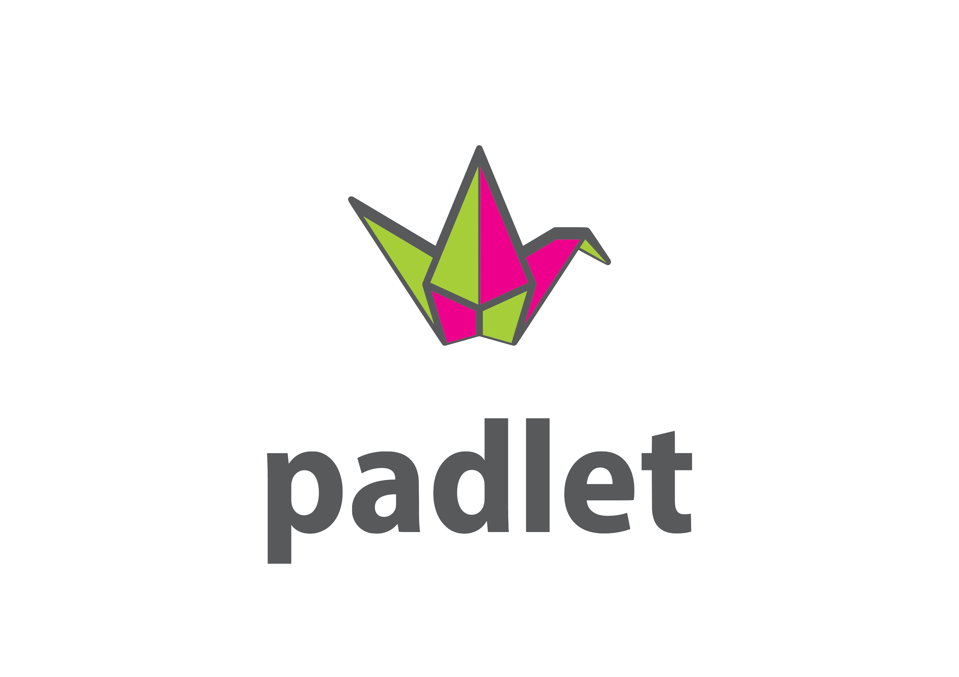
The effective use of the Padlet board platform in a blended (hybrid) learning to improve students writing skills.
Dias Kabdenov, NIS Karaganda

Slide 2
Have you ever used online learning platforms? If yes, where and why?

Slide 3
How do online learning platforms affect the learning process?

Slide 4
The PADLET platform helps students develop the following SKILLS.
PADLET
Grammar
Vocabulary
Writing skills
Assessment/ Feedback

Slide 5
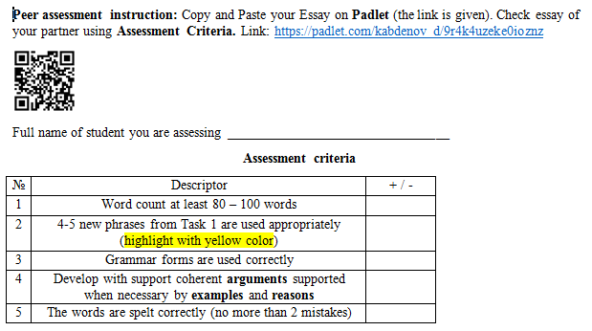
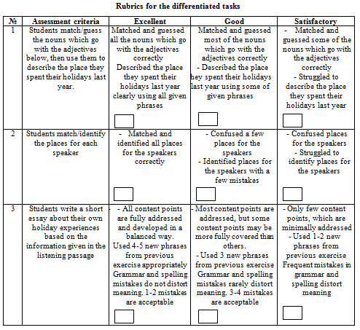
Padlet online platform in USE

Slide 7
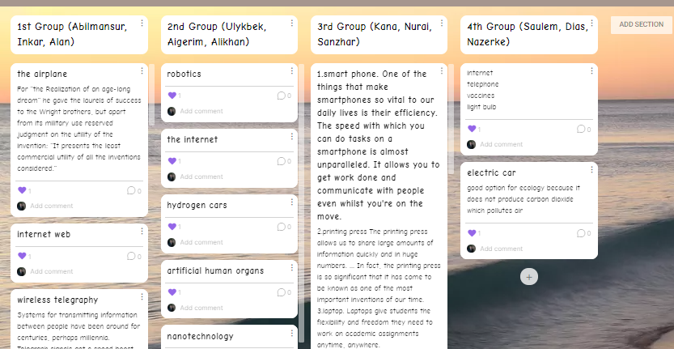

Slide 8
PADLET: Assessment/ Feedback
Students
Can evaluate himself / herself or classmates based on descriptors provided by the teacher
Teachers
Can provide full feedback to colleagues during the exchange of experiences
Can determine the learning level of the given materials

